Slide 1
Application of Improper Integrals
Area
Volume

Slide 2
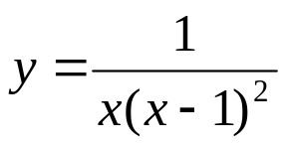
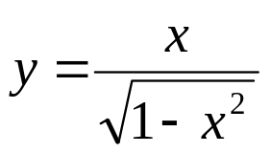
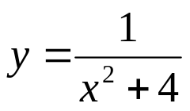

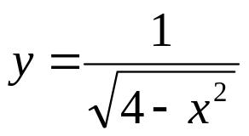
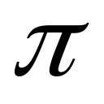
Area
Find the area of the region
1. above the x-axis under and to the
right of x =2. Ans: 1 – ln 2 sq.unit
2. between the curves , the x –axis ,
x= 0 and x =1. Ans: 1 sq.unit
3. bounded by and the x –axis. Ans:
4. bounded by the curve , its
asymptotes and the x-axis. Ans:

Slide 3
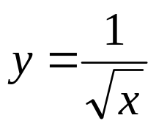
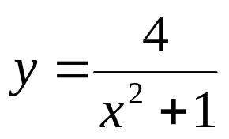
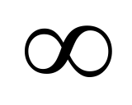

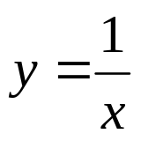

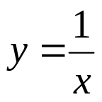
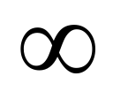
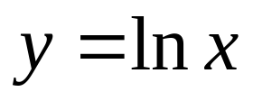


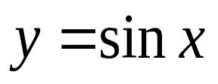
5. bounded by and the line x = 1.
6. bounded by the curve , the x-axis
and to the right of the line x = 1.
7. under the curve , for x ≥ 1. Ans:
8. under between x = 0 and x =1 Ans:
9. under and to the right of x =1 Ans:
10. under from the right of x =1.
11. under from x = 0 to x = .
12. under for x ≥ 0

Slide 4
Volume
Find the volume of the solid
under the curve xy =1, for x≥1 is rotated about the x-axis.
between the graph of y = ln (1/x), the x-axis, and the y-axis is revolved about the x-axis.
That is generated when the region between the x-axis and the curve y = 1/e^{x} for x≥0 is revolved about the x-axis.

